Slide 1
Confirmation Questions
Catholic Diocese of Raleigh

Slide 2
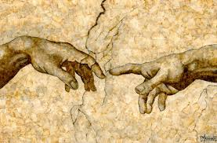
Humans
1. Who made us?
God. (CCC 355; Gn 1:1, 26-27; Gn 2:7, 21-22)
2. Why did God make us?
To know, love, and serve Him in this life; and to be happy with Him forever in Heaven. (CCC 1, 358; Deut 10:12-15; Jn 17:3)
3. Why are humans more important than animals and the rest of creation?
Because men and women are created in the image and likeness of God. (CCC 2417, 2418; Gn 2:19-20; 9:1-4)

Slide 3
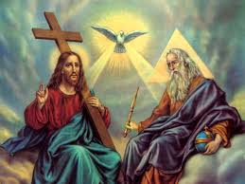
God
4. How many Gods are there?
One (CCC 253; Ex 3:14; Jn 8:58)
5. How many Persons are there in God? What are their names?
There are three persons in God: God the Father, God the Son, and God the Holy Spirit. (CCC 252, 254, 255; 1 Cor 12, 4-6; 2 Cor 13:13; Eph 4:4-6)

Slide 4
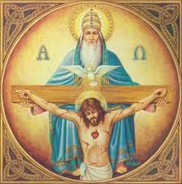
God continued
6. Is the Father God?
Yes (CCC 253, 262; Ex 3:6; Ex 4:22)
7. Is the Son God?
Yes (CCC 253, 262; Jn 8:58; Jn10:30)
8. Is the Holy Spirit God?
Yes (CCC 253, 263; Jn 14:26; Jn 15:26)
9. What do we call the mystery of three persons in one God?
The Blessed or Holy Trinity (CCC 249, 251; Mt 28:19)

Slide 5
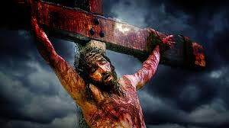
Jesus
10. Which Person of the Holy Trinity became man?
The Second Person, God the Son, became man without giving up His divine nature. (CCC 423, 464; 1 Jn 4:2)
11. What name was given to the Second Person of the Holy Trinity when He became man?
Jesus (CCC 430; Lk 1:31; Mt 1:21)
12. When the Son became man, did He have a human mother?
Yes (CCC 488, 490, 495; Lk 1:26, 27)

Slide 6
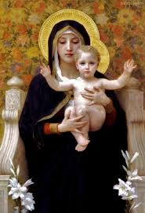
Mary
13. Who was Jesus’ mother?
The Blessed Virgin Mary (CCC 488, 495; Lk 1:30, 31; Mt 1:21-23)
14. Why do we honor Mary?
Because she is the mother of Jesus and our mother too. (CCC 971; Lk 1:48; Jn 19:27)

Slide 7
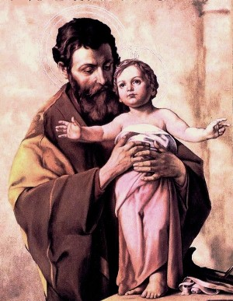
Jesus’ Father
15. Who was Jesus’ real father? (careful)
God the Father. (CCC 422, 426, 442; Lk 1:35)
16. Who was Jesus’ foster father?
Joseph. (CCC 437, 488, 1655; Mt 1:19, 20; Mt 2:13, 19-21)

Slide 8
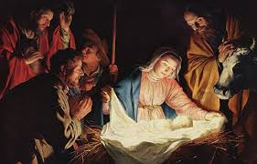
Humanity and Divinity of Jesus
17. Is Jesus God, or is He man, or is He both God and man?
Jesus is both God and man; as the Second Person of the Holy Trinity, He is God; and since He took on a human nature from His mother Mary, He is man. (CCC 464, 469; Jn 1:14, 16; Jn 13:3; 1 Jn 4:2)
18. What do we call the mystery of God becoming man?
The mystery of the Incarnation. (CCC 461, 463; Jn 1:14; 1 Jn 4:2)

Slide 9
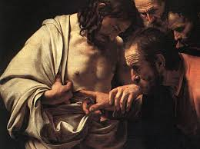
Death, Resurrection, and Ascension of Jesus
19. On what day did Jesus die on the cross?
Good Friday, the day after the Last Supper. (CCC 641; Jn 19:16-40; Mt 27:33-50)
20. On what day did Jesus rise from the dead?
On Easter Sunday, three days after Good Friday. (CCC 1169, 1170; Mt 28:1-6; Mk16:1-8)
21. When did Jesus ascend into Heaven?
On Ascension Thursday, forty days after Easter. (CCC 659; Acts 1:9; Mk 16:19)

Slide 10
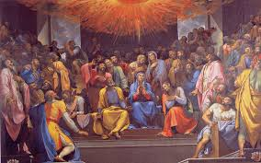
Pentecost
22. When did the Holy Spirit descend upon the Apostles?
On Pentecost Sunday, fifty days after Easter. (CCC 731, 1302; Jn 20:21, 22; Mt 28:19)

Slide 11
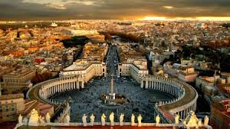
Redemption
23. What is meant by the Redemption?
Redemption means that Jesus’ incarnation, life, death, and resurrection paid the price for our sins, opened the gates of Heaven, and freed us from slavery to sin and death. (CCC 517, 606, 613; Eph 1:7; Rm 4:25)
24. What did Jesus establish to continue his mission of Redemption?
He established the Catholic Church (CCC 773, 778, 817, 822; Mt 16:18; Rev 21:9)

Slide 12
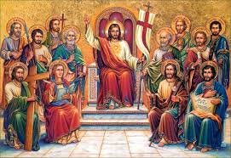
One True Church
25. Why do we believe that the Catholic Church is the one true Church?
Because it is the only Church established by Jesus. (CCC 750; Mt 16:18)
26. Does it matter to which Church or religion you belong?
Yes, in order to be faithful to Jesus, it is necessary to remain in the Church he established. (CCC 846; Mk 16:16; Jn 3:5)

Slide 13
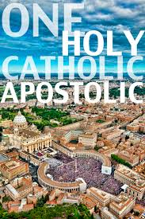
4 Marks of the Church
27. What are the Four Marks of the Church?
One, Holy, Catholic, and Apostolic. (CCC 813, 823, 830, 857; Eph 2:20, 4:3, 5:26; Mt 28:19; Rev 21:14)

Slide 14
Scripture and Tradition
28. How does the Church preserve the teachings of Jesus?
Through Sacred Scripture and Sacred Tradition. (CCC 78, 81, 82; 2 Tim 2:2; 2 Thess 2:15)

Slide 15
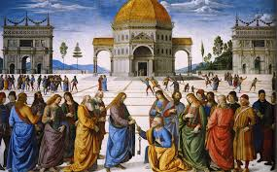
Apostolic Authority
29. Did Jesus give special authority to one of the Apostles?
Yes, to Peter when Jesus said to him, “I will give you the keys of the kingdom of heaven, and whatever you bind on earth shall be bound in heaven, and whatever you loose on earth shall be loosed in heaven." (CCC 552, 881; Mk 3:16, 9:2; Lk 24:34)
30. Who speaks with the authority that Jesus gave to St. Peter?
The pope who is St. Peter’s successor, the Bishop of Rome, and the Vicar of Christ on earth. (CCC 891; Mt 16:18; Jn 21:15-17; 1 Cor 15:5)

Slide 16
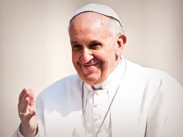
Present Pope
31. What is the name of the present pope?
Pope Francis. (CCC 936; Mt 16:18; Jn 21:15-17)

Slide 17
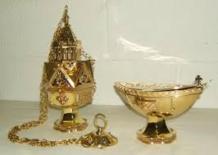
Sacred Liturgy
32. What is the sacred liturgy?
The Church’s public worship of God. (CCC 1069, 1070; Jn 4:23-24)
33. What attitude should we have when we participate in the sacred liturgy?
We should have the attitude of reverence in our hearts and respect in our actions and appearance. (CCC 2097; Heb 12:28)

Slide 18
Sacraments
34. What is a sacrament?
A sacrament is an outward sign, instituted by Christ, to give grace. (CCC 1131; 2 Pet 1:4)
35. How many sacraments are there?
Seven. (CCC 1113; Mt 28:16; Jn 20:22-23; Lk 22:14-20; Jn 7:37-39; Jas 5:14-16; Heb 5:1-6; Mt 19:6)
36. What are the seven sacraments; and which ones have you received?
Baptism, Penance, Holy Eucharist, Confirmation, Holy Orders, Matrimony, Anointing of the Sick. We have received Baptism, Penance, and Holy Eucharist. (CCC 1113; Mt 28:16; Jn 20:22-23; Lk 22:14-20; Jn 7:37-39; Jas 5:14-16; Heb 5:1-6;Mt 19:6)

Slide 19
37. What are the sacraments you can only receive once?
Baptism, Confirmation, and Holy Orders. CCC 1272; Eph 4:30
38. When you were born, did you have Sanctifying Grace (a share in God’s life)?
No. CCC 403, 1250; Col 1:12-14

Slide 20
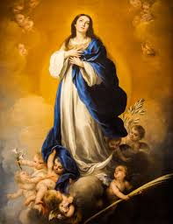
Original Sin
39. Why are we not born with Sanctifying Grace?
Because we are born with original sin which is the loss of Sanctifying Grace. (CCC 403, 1250; Gn 3:23)
40. Was any human person conceived without original sin?
Yes, Mary at her Immaculate Conception. (CCC 491, 492; Lk 1:28)

Slide 21
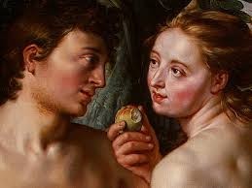
Original Sin
41. What was the original sin?
Adam and Eve were tempted by the devil; and they chose to distrust God’s goodness and to disobey His law. (CCC 397; Gen 3:1-11; Rm 5:19)

Slide 22
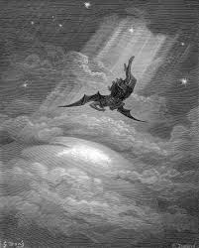
Evil
42. Is there really a devil?
Yes. (CCC 391; 1 Jn 5:19; 1 Pet 5:8)
43. Is it easier to be bad or to be good?
It is easier to be bad, because original sin has left us with an inclination to sin called concupiscence. (CCC 409, 1264, 2516; Rom 7:15-18)

Slide 23
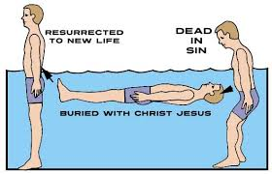
Baptism
44. When did you receive Sanctifying Grace for the first time?
At Baptism. (CCC 1265; 2 Cor 5:17)
45. What did Baptism do for you?
It gave me a share in God’s life for the first time, made me a child of God, and took away original sin. (CCC 1266, 1279; 2 Cor 5:17; 2 Pet 1:4; Gal 4:5-7)

Slide 24
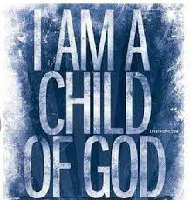
Being a Child of God
46. How long do you remain a child of God?
Forever. (CCC 1272, 1274; 1 Pet 1:3, 4)
47. Can you lose a share in God’s life after Baptism?
Yes. (CCC 1861; Mk 3:29)
48. How can you lose Sanctifying Grace (a share in God’s life)?
By committing mortal sin. (CCC 1861; Gal 5:19-21; Rom 1:28-32)

Slide 25
Sin
49. What are the two kinds of personal sin (sin we commit ourselves)?
Venial and mortal sin. (CCC 1855; 1 Jn 5:16, 17)
50. Which is the worse?
Mortal (deadly) sin. (CCC 1855, 1874, 1875; 1 Jn 5:16)

Slide 26
Mortal Sin
51. What three things are necessary to commit a mortal sin?
1. You must disobey God in a serious matter.
2. You must know that it is wrong.
3. You must freely choose to do it anyway. (CCC 1857; Mk 10:19; Mk 3:5-6; Lk 16:19-31)

Slide 27
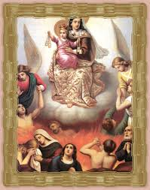
Hell and Purgatory
52. What happens to you if you die in a state of mortal sin?
You go to hell. (CCC 1035, 1472, 1861, 1874; 1 Jn 3:14-15; Mt 25:41-46)
53. Is there really a hell?
Yes, it is the place of eternal separation from God. (CCC 1035; Is 66:24; Mk 9:47, 48)
54. What happens if you die with venial sin on your soul?
You go to purgatory where you are purified and made perfect. (CCC 1030, 1031, 1472; 1 Cor 3:15; 2 Mc 12:46)

Slide 28
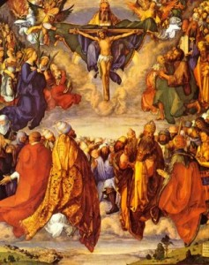
Heaven
55. What happens to the souls in purgatory after their purification?
They go to Heaven. (CCC 1030; 2 Mc 12:46)
56. Is there really a Heaven?
Yes; it is the place of eternal happiness with God. (CCC 1023, 1024; 1 Jn 3:2; 1 Cor 13:12; Rev 22:4)

Slide 29
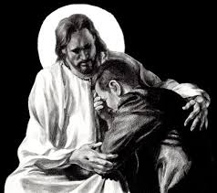
Forgiveness of Sins
57. Can any sin, no matter how serious, be forgiven?
Yes, any sin, no matter how serious or how many times it is committed can be forgiven. (CCC 982; Mt 18:21, 22)
58. How can a mortal sin be forgiven?
Through the sacrament of Confession. (CCC 1446, 1497; 2 Cor 5:20, 21)

Slide 30
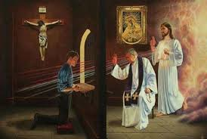
Confession
59. What three things must you do in order to receive forgiveness of sin in the sacrament of Confession?
1. You must be truly sorry for your sins.
2. Confess all mortal sins in kind and number committed since your last Confession.
3. You must resolve to amend your life. (CCC 1448; Rom 8:17; Rom 3:25, 26)
60. Who has the power to forgive sin?
Jesus Christ through a Catholic priest. (CCC 1461, 1495; Jn 20:23; 2 Cor 5:18)

Slide 31
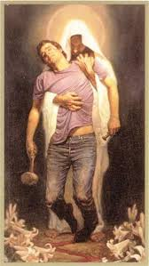
Confession
61. How often should you go to Confession?
You should go immediately if you are in a state of mortal sin; otherwise, it is recommended to go once a month. (CCC 1457, 1458; Lk 6:36)

Slide 32
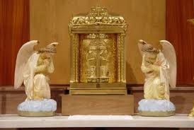
Blessed Sacrament
62. Where in the Church building is Jesus present in a special way?
In the tabernacle. (CCC 1379; Ex 40:34; Lk 22:19; Jn 13:1)
63. True or False. When you receive Holy Communion, you receive a piece of bread that signifies, symbolizes, or represents Jesus.
False. (CCC 1374, 1413; Mt 26:26 ff)

Slide 33
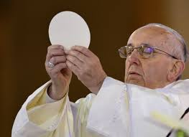
Consecration at Mass
64. What, or Whom, do you receive in Holy Communion?
The Body, Blood, Soul, and Divinity of Christ. (CCC 1374, 1413; 1 Cor 11:24 ff)
65. When is the Host changed from bread to the Body and Blood of Christ?
It is changed by the words of the priest at the consecration during Mass. (CCC 1412, 1413; Mk 14:22 ff, Lk 22:19)

Slide 34
Sacrilege
66. Should you receive Holy Communion in the state of mortal sin?
No. If you do, you commit the additional mortal sin of sacrilege. (CCC 1385, 1457; 1 Cor 11:27-29)
67. What is sacrilege?
It is the abuse of a sacred person, place, or thing. (CCC 2120; 1 Cor 11:27-29)
68. If you are in a state of mortal sin, what should you do before receiving Holy Communion?
You should go to Confession as soon as possible. (CCC 1385, 1457; 2 Cor 5:20)

Slide 35
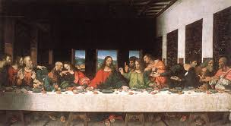
The First Mass
69. Who offered the first Mass?
Jesus Christ. (CCC 1323; Mk 14:22-24)
70. When did Jesus offer the first Mass?
On Holy Thursday night, the night before He died, at the Last Supper. (CCC 1323; Mt 26:26-28)

Slide 36
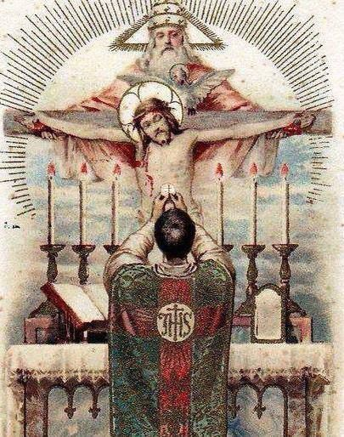
The Mass
71. What is the Sacrifice of the Mass?
It is the sacrifice of Jesus Christ on Calvary, made present when the priest repeats the words of consecration spoken by Jesus over the bread and wine at the Last Supper. (CCC 1364, 1413; Heb 7:25-27)
72. How do we participate in the Sacrifice of the Mass?
By uniting ourselves and our intentions to the bread and wine, offered by the priest, which become Jesus’ sacrifice to the Father. (CCC 1407; Rom 12:1)

Slide 37
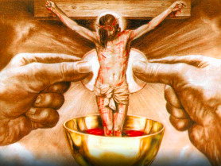
Sundays and Holy Days of Obligation
73. Is it a mortal sin for you to miss Mass on Sunday or a Holy Day through your own fault?
Yes. (CCC 2181; Ex 20:8)

Slide 38
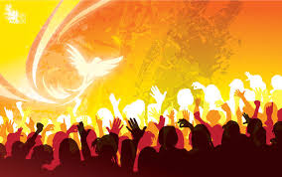
Confirmation
74. Which person of the Holy Trinity do you receive in Confirmation?
The Holy Spirit. (CCC 1302; Rom 8:15)
75. What happens in the Sacrament of Confirmation?
The Holy Spirit comes upon us and strengthens us to be soldiers of Christ that we may spread and defend the Catholic faith. (CCC1303, 2044; Jn 14:26; 15:26)

Slide 39
Confirmation
76. What are the Seven Gifts of the Holy Spirit?
wisdom, understanding, counsel, fortitude, knowledge, piety, and fear of the Lord. (CCC 1830, 1831; Is 11:2-3)
77. Before you are confirmed, you will promise the Bishop that you will never give up the practice of your Catholic faith for anyone or anything. Did you ever make that promise before?
Yes, at Baptism. (CCC 1298; Jos 24:21-22)

Slide 40
Infant Baptism
79. What kind of sin is it to receive Confirmation in the state of mortal sin?
A sacrilege. (CCC 2120; 1 Cor 11:27-29)
80. If you have committed mortal sin, what should you do before receiving Confirmation?
You should make a good Confession. (CCC 1310; 2 Cor 5:20; Lk 15:18)
78. Most of you were baptized as little babies. How could you make that promise?
Our parents and godparents made that promise for us. (CCC 1253; Mk 16:16)

Slide 41
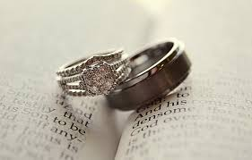
Vocations
81. What are the three traditional vocations?
Married life, Holy Orders, and the consecrated life. (CCC 1601, 1536, 914; Eph 5:31, 32; Heb 5:6, 7:11; Ps 110:4; Mt 19:12; 1 Cor 7:34-66)
82. What are the three vows that a consecrated man or woman takes?
Chastity, Poverty and Obedience. (CCC 915; Mt 19:21; Mt 19:12; 1 Cor 7:34-36; Heb 10:7)

Slide 42
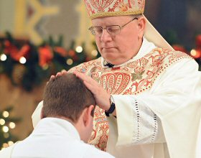
Holy Orders
83. What are the three ranks (degrees) of Holy Orders?
Deacon, Priest, and Bishop. (CCC 1554; 1 Tim 4:14; 2 Tim 1:6-7)

Slide 43
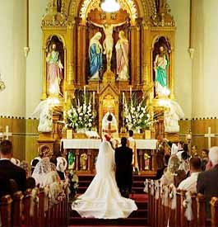
Marriage
84. For whom did God make marriage?
One man and one woman. (CCC 1601, 2360; Gen 1:26-28; Eph 5:31)
85. Is it possible for two men or two women to get married?
No. (CCC 2360, 2357; Gen 19:1-29; Rom 1:24-27; 1 Cor 6:9)

Slide 44
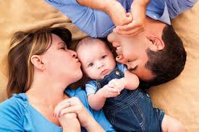
Marriage
86. When can a man and woman begin living together?
Only after their marriage. (CCC 235; 1 Cor 6:18-20)
87. What are the three marriage promises a husband and wife make to each other?
Faithfulness, permanence, and being open to having children. (CCC 1640, 1641, 1664; Mt 19:6; Gen 1:28)

Slide 45
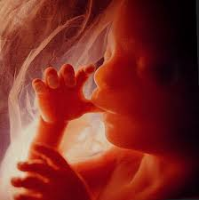
Abortion
88. Why is abortion wrong?
Because it takes the life of a baby in its mother’s womb. (CCC 2270; Jer 1:5)

Slide 46
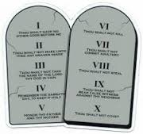
Commandments
89. How many commandments are there?
Ten. (CCC 2054; Ex 20:1-18; Dt 5:6-21)
90. What are the Ten Commandments?
I, the Lord, am your God. You shall not have other gods besides me.
You shall not take the name of the Lord, your God, in vain.
Remember to keep holy the Lord’s Day.
Honor your father and mother.
You shall not kill.
You shall not commit adultery.
You shall not steal.
You shall not bear false witness against your neighbor.
You shall not covet your neighbor’s wife.
You shall not covet your neighbor’s goods. (CCC pp. 496, 497; Ex 20:1-18; Dt 5:6-21)

Slide 47
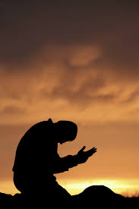
Prayer
91. What are the four main kinds of prayer?
The four main kinds of prayer are adoration, thanksgiving, petition and intercession. (CCC 2628, 2629, 2634, 2638, 2639; Ps 95:6; Col 4:2; Jas 5:16; 1 Jn 3:22)
92. How often should we pray?
Every day. (CCC 2742; Lk 18:1)

